Slide 1
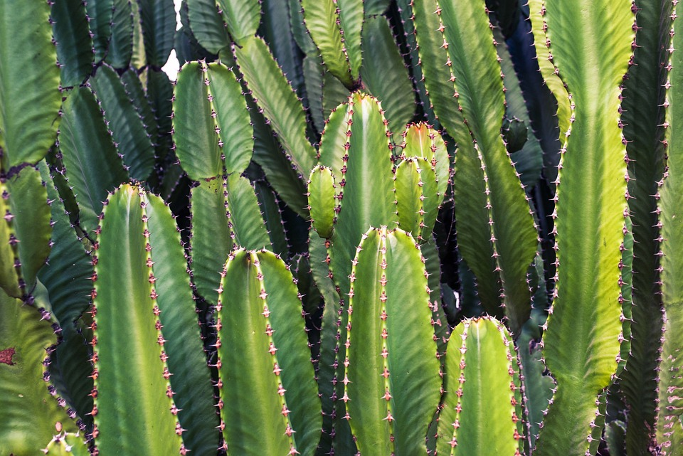
AI-POWERED PROJECT
Team Members:
B.SARSWATHI
T.LAXMILASYA
T.JAGRUTHI

Slide 2
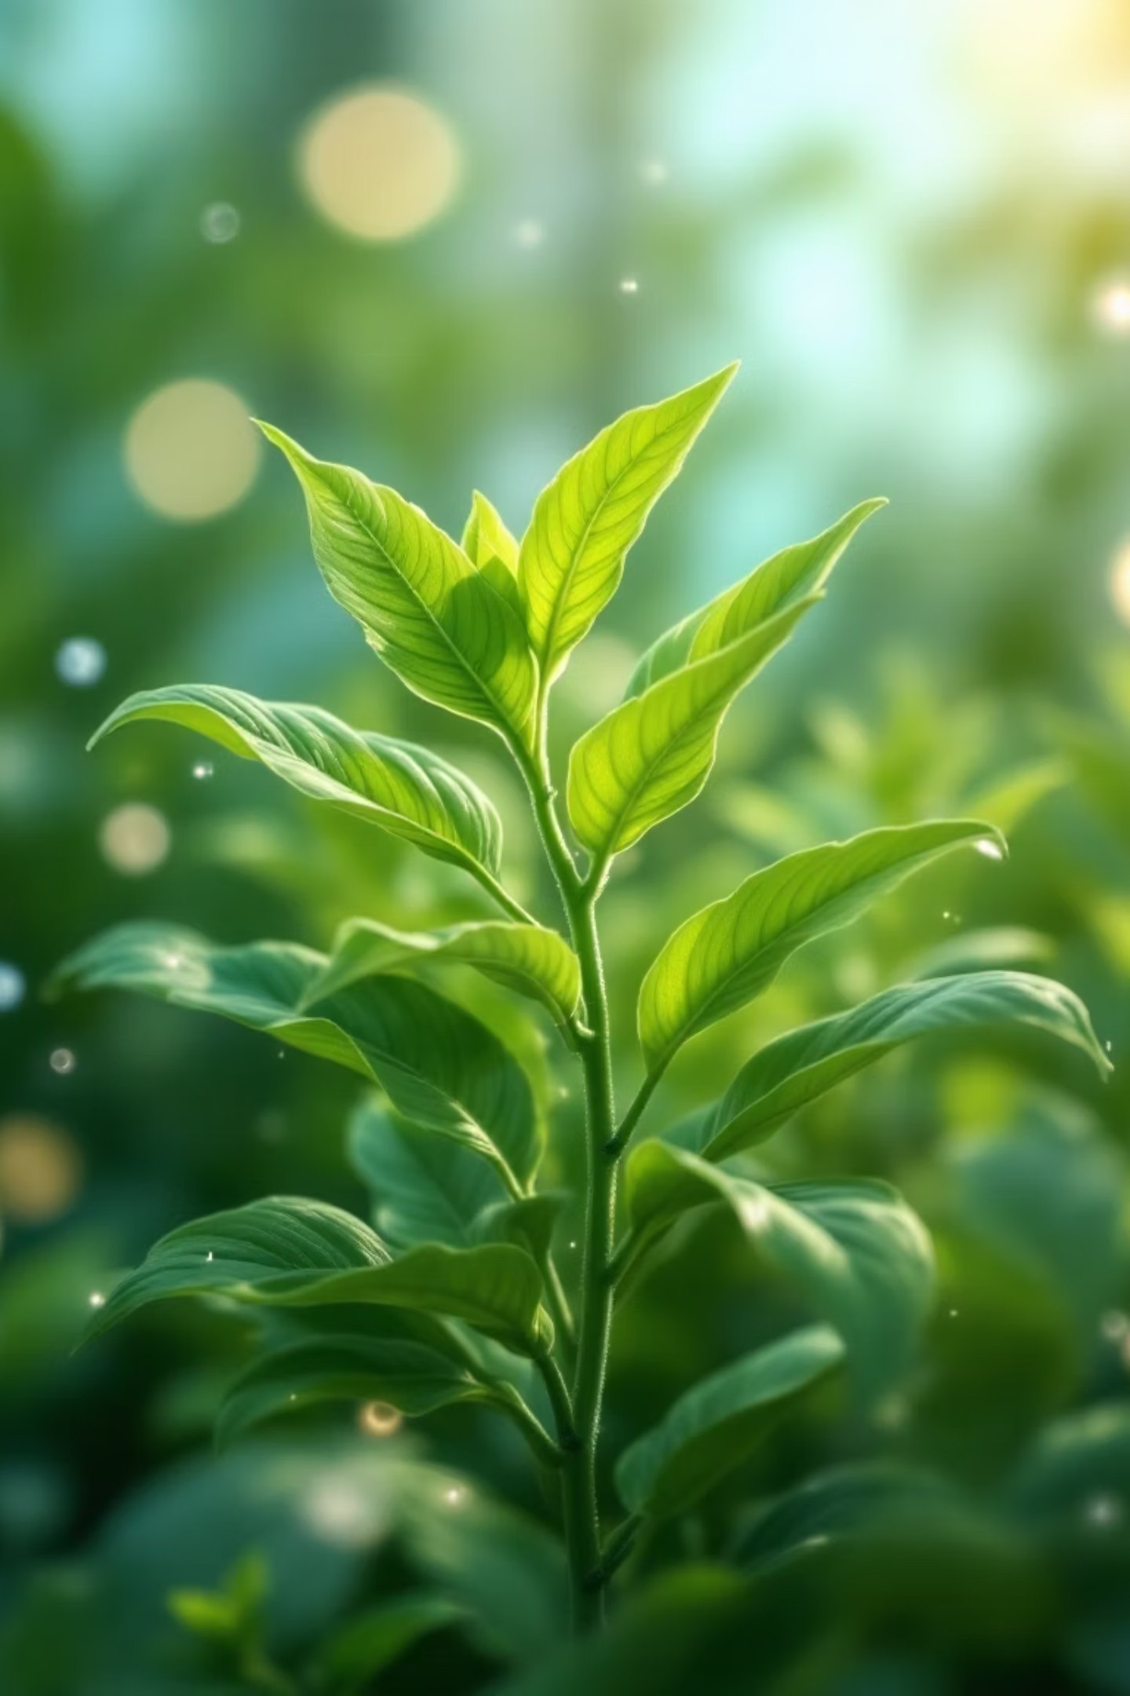
Your AI-Powered Plant Care Advisor
Unlock the secrets to thriving plants with intelligent guidance.

Slide 3
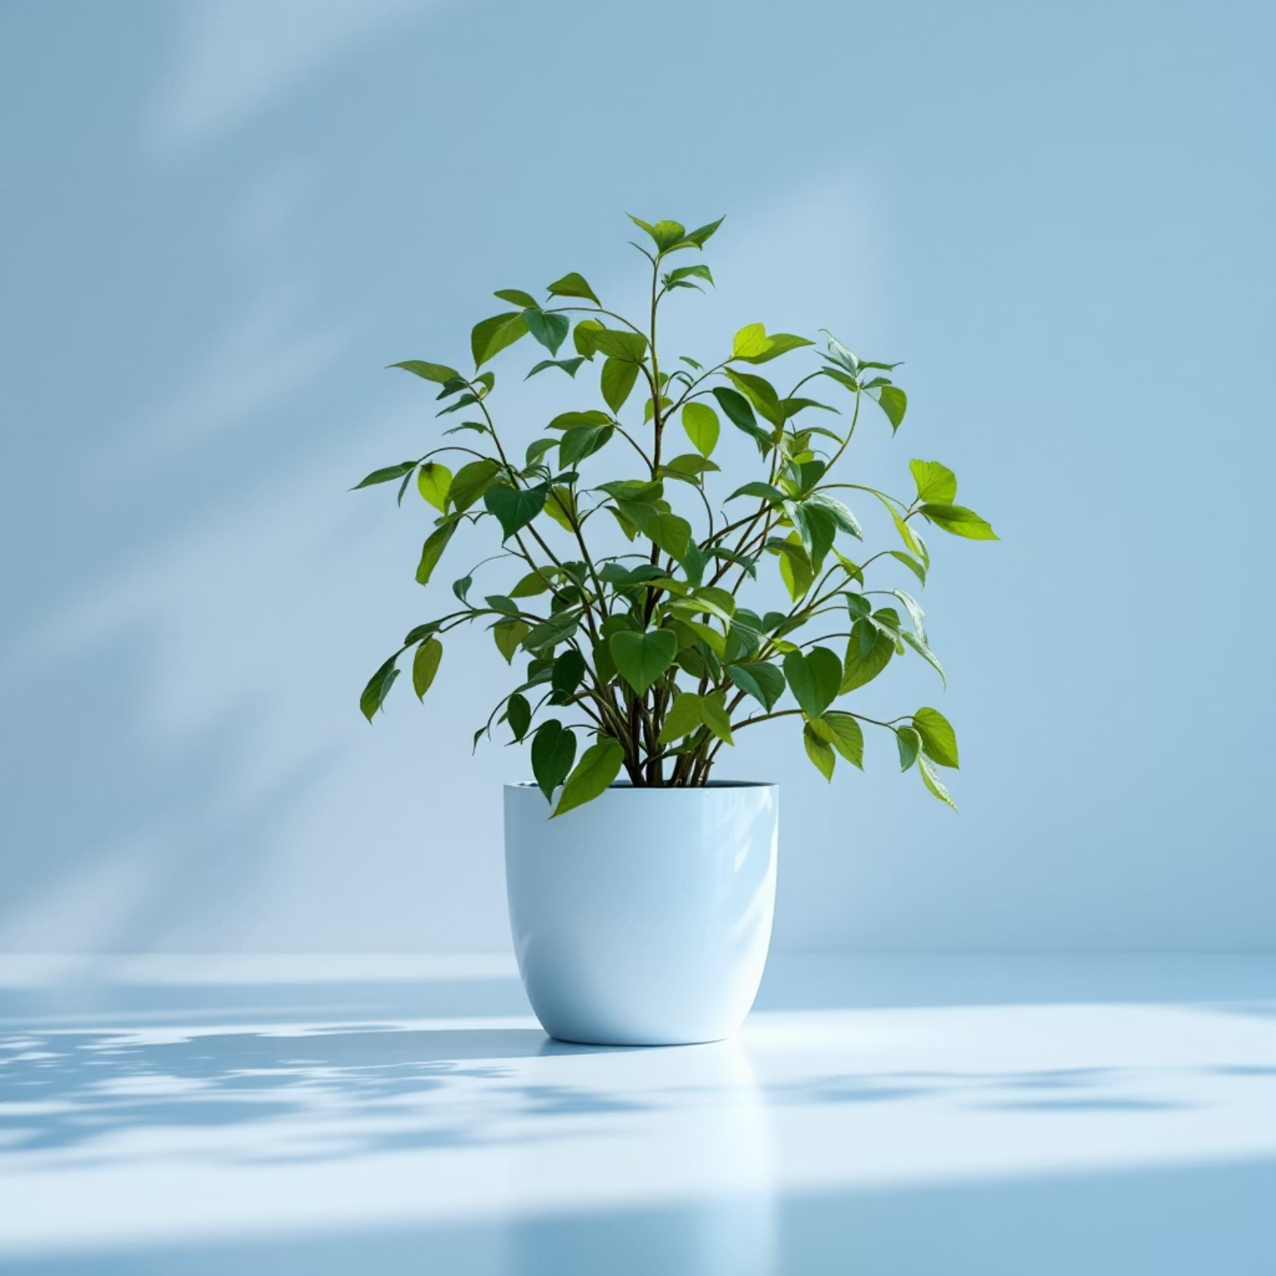
The Problem: Why Are Our Plants Dying?
Common Challenges:
Misidentification
Incorrect care
Pest & disease issues
Environmental stress
And How AI Can Help!

Slide 4
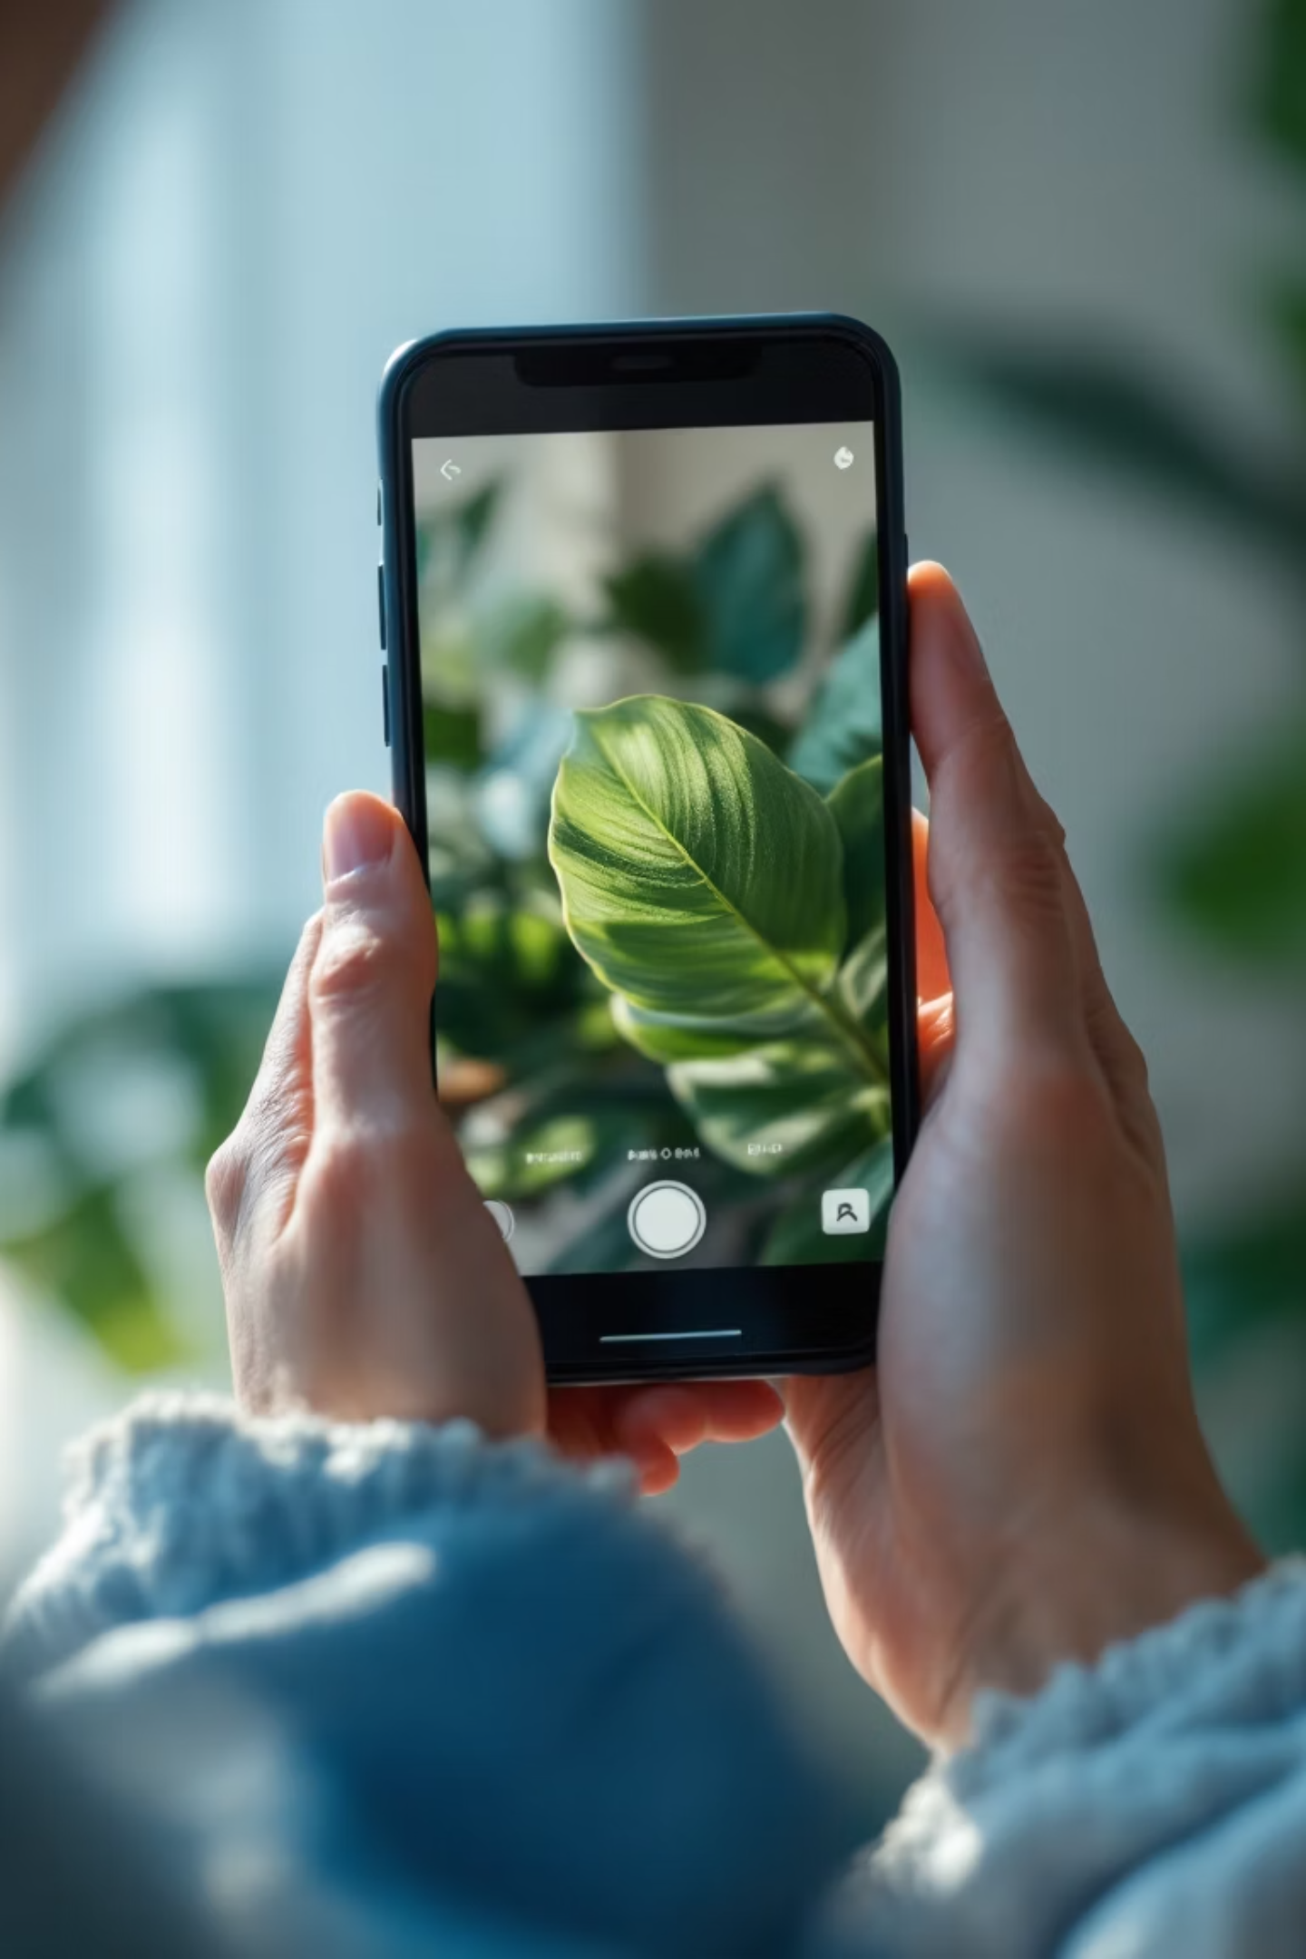

Simple to Use: Upload and Diagnose
Capture Images
Take clear photos of your plant, focusing on any problem areas like leaves, stems, or flowers.
Upload to Advisor
Easily upload your images to our AI-powered platform for instant analysis.
Receive Insights
Get immediate feedback on your plant's health and identification.

Slide 5
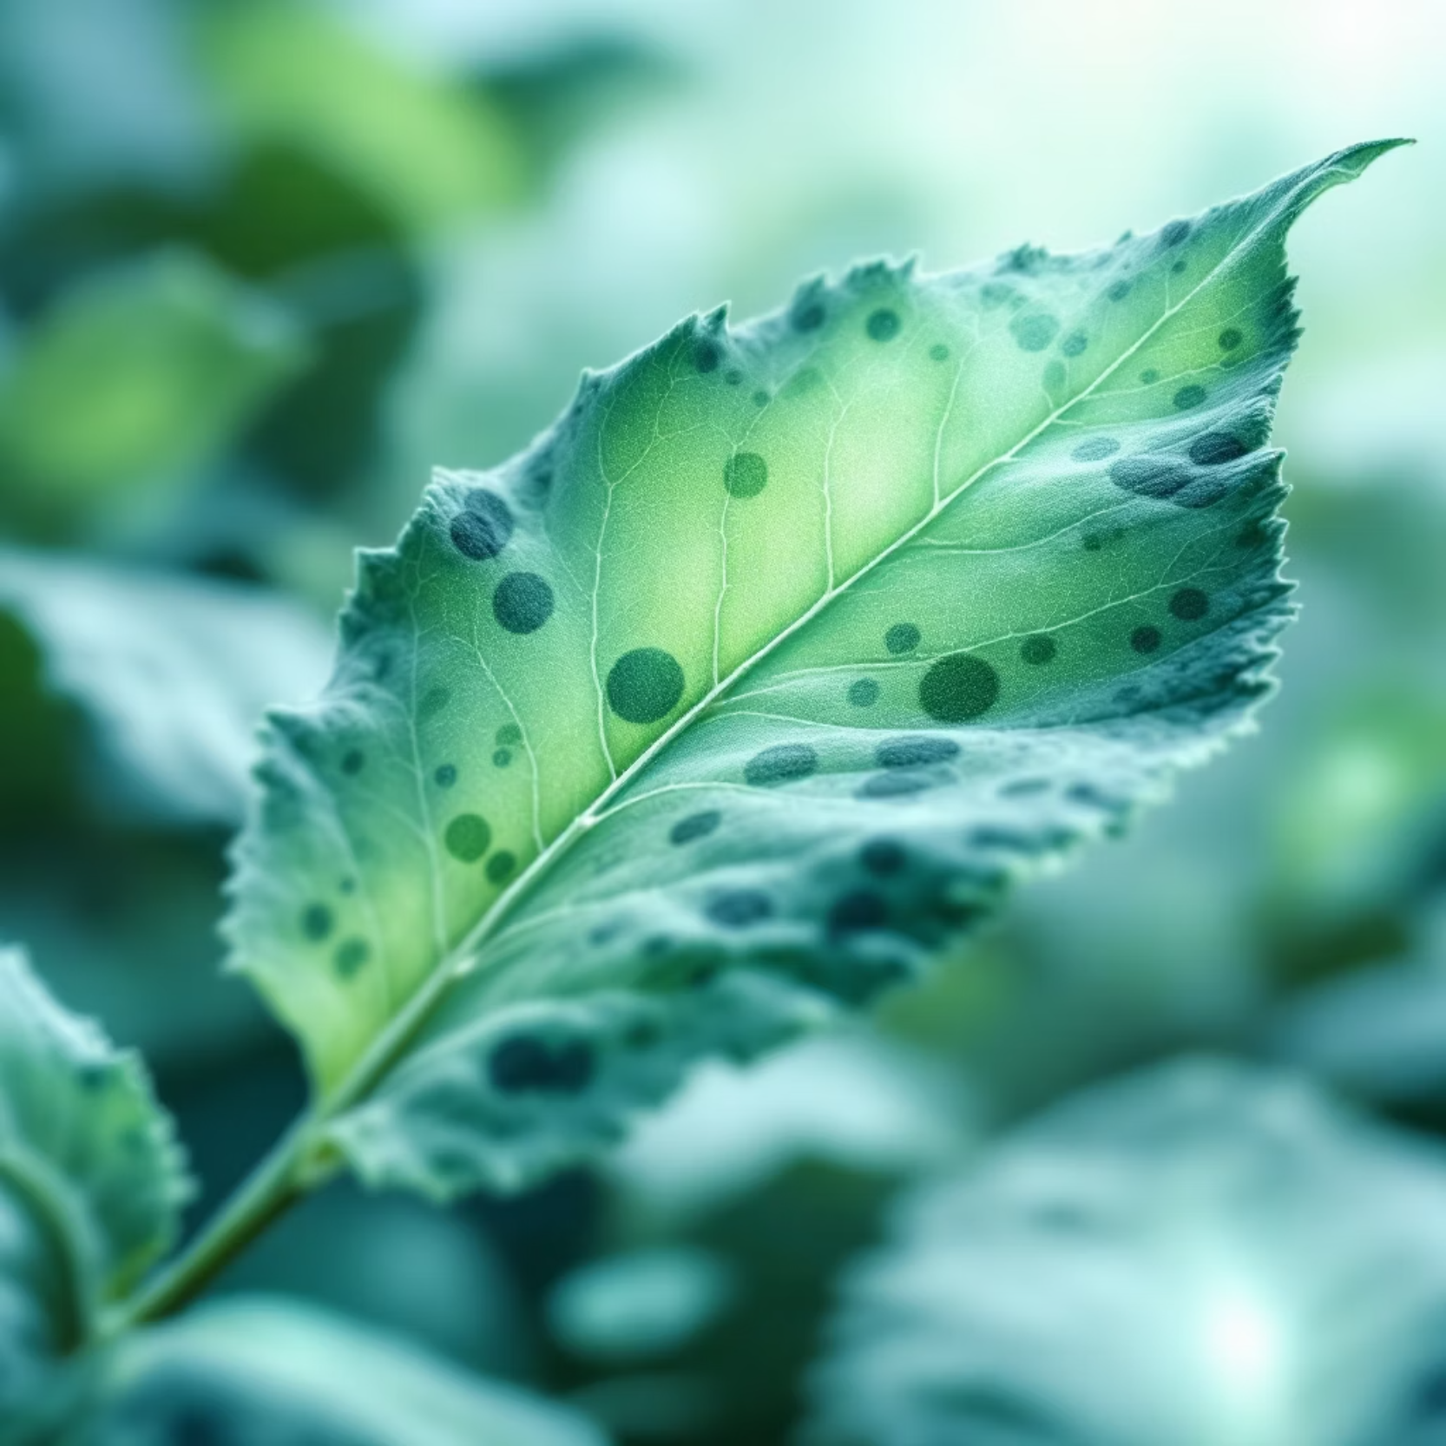
Instant Health Status & Issue Detection
Precise Diagnostics:
Disease identification
Pest detection
Nutrient deficiencies
Stress indicators
Know exactly what's wrong, fast.

Slide 6
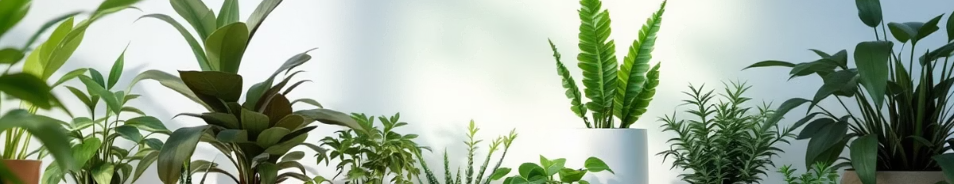
Intelligent Plant Identification & Health Analysis
Species Recognition
Symptoms Analysis
Severity Assessment
Accurately identify your plant from a vast database.
Understand the root cause of any health issues.
Gauge how critical the problem is and recommended urgency.

Slide 7
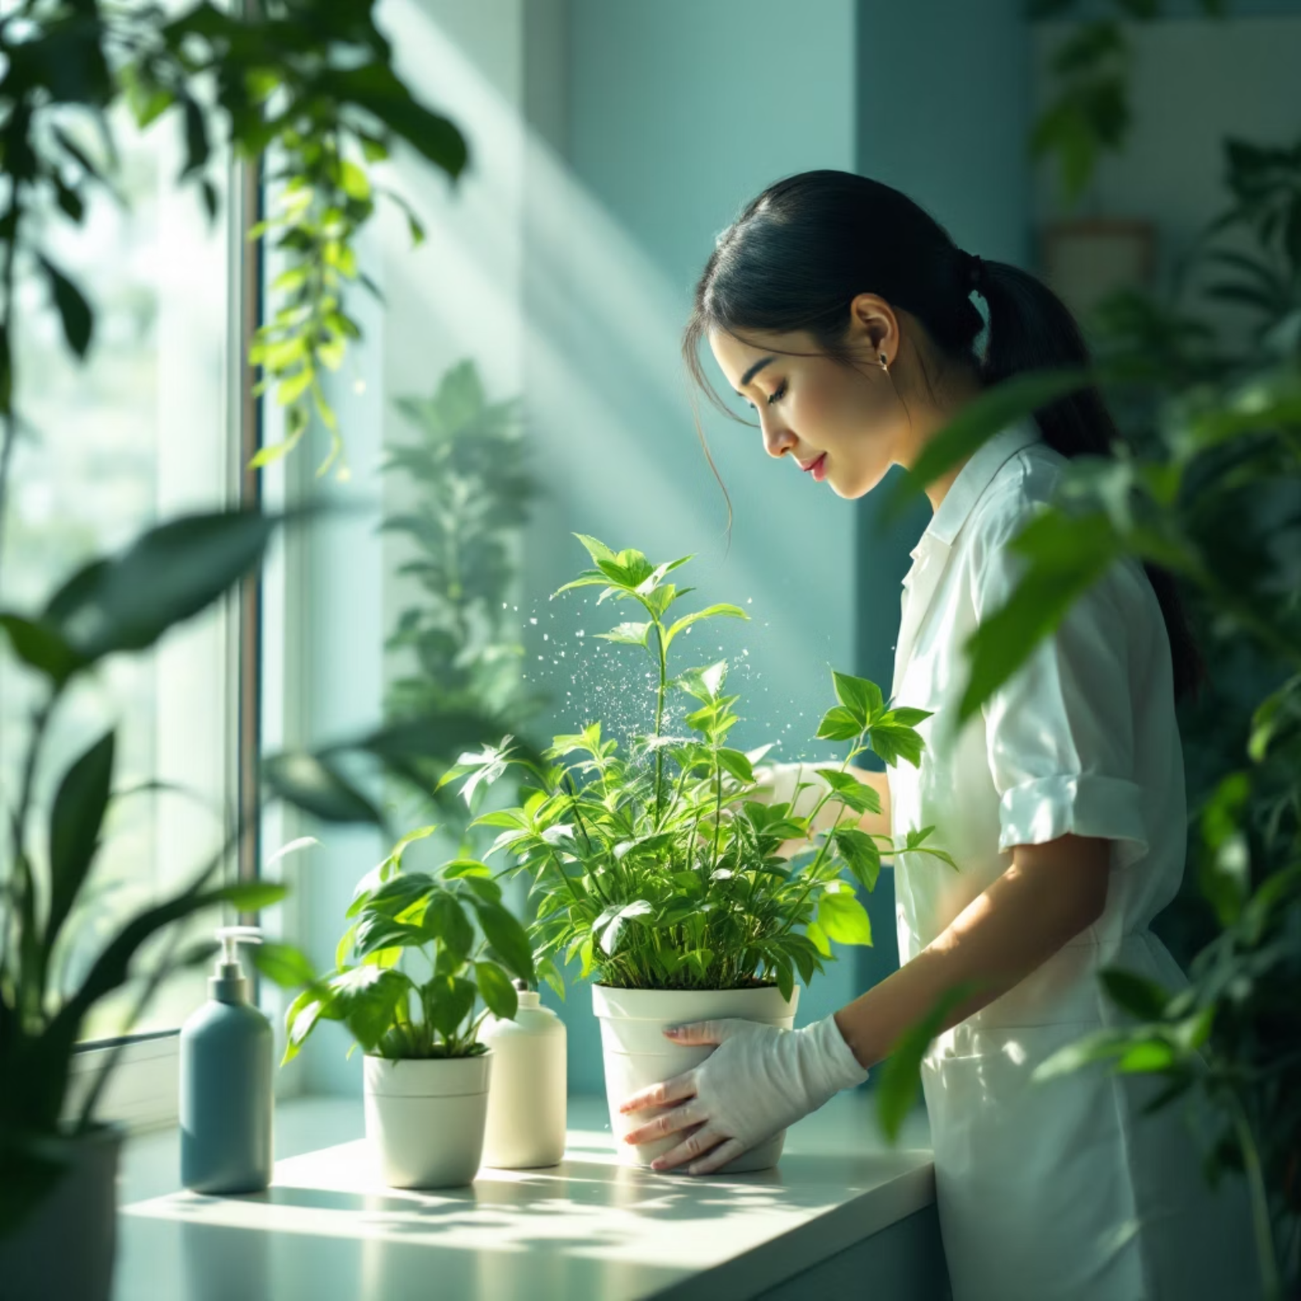
Personalised Care Instructions
Optimal watering schedule
Ideal sunlight exposure
Fertiliser recommendations
Temperature & humidity guidelines
Tailored advice for your specific plant.

Slide 8

Ensuring Environment Suitability
Outdoor Environment
Perfect Spot
Indoor vs Outdoor
Optimal Growth Zone
Needs vs Outdoors
Indoor Conditions
Plant Needs
Matching your plant to the perfect spot for optimal growth.

Slide 9
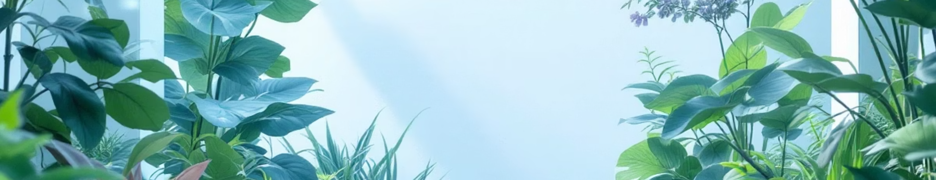



AI: Faster & Better Than Traditional Methods
Speed
Accuracy
Proactive Care
Instant diagnosis vs. waiting for expert opinions.
Vast data analysis for precise recommendations.
Prevent issues before they become critical.

Slide 10
THANK YOU!!

